Slide 1
Redistricting In The Real World in South Carolina
John Ruoff
Jruoff@TheRuoffGroup.com
803-603-3224
May 7, 2019

Slide 2
Traditional Districting Principles in South Carolina
Reasonably Compact districts
Contiguous districts
Preserve Political Subdivisions, including precincts, wards, etc.
Preserve Communities of Interest
Preserve Cores of Prior Districts
Protect Incumbents

Slide 3
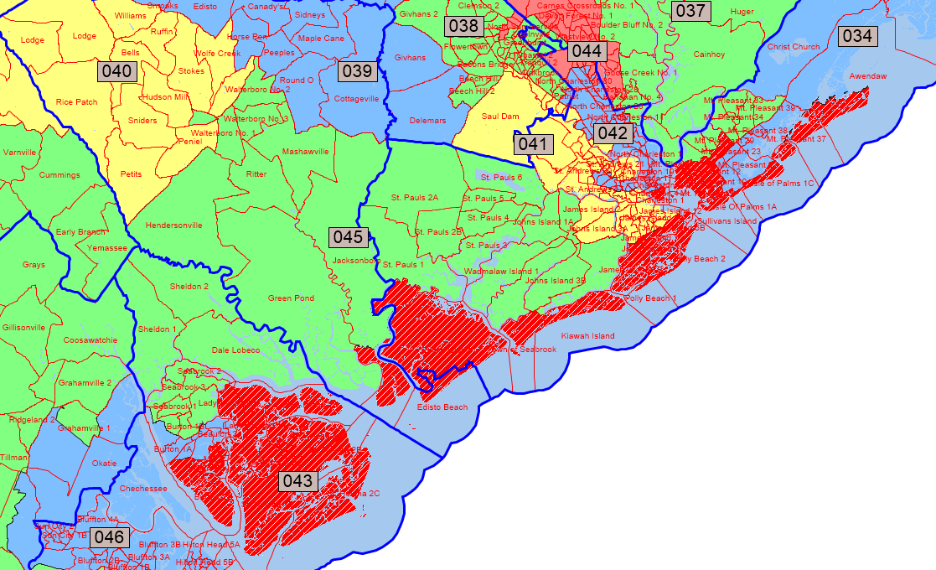
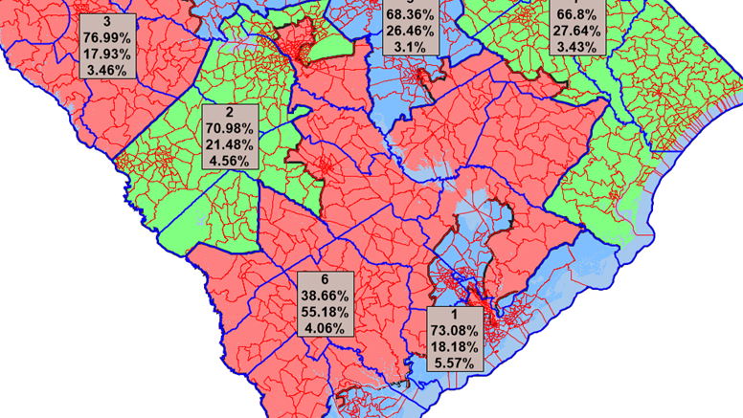

Reasonably Compact

Slide 4
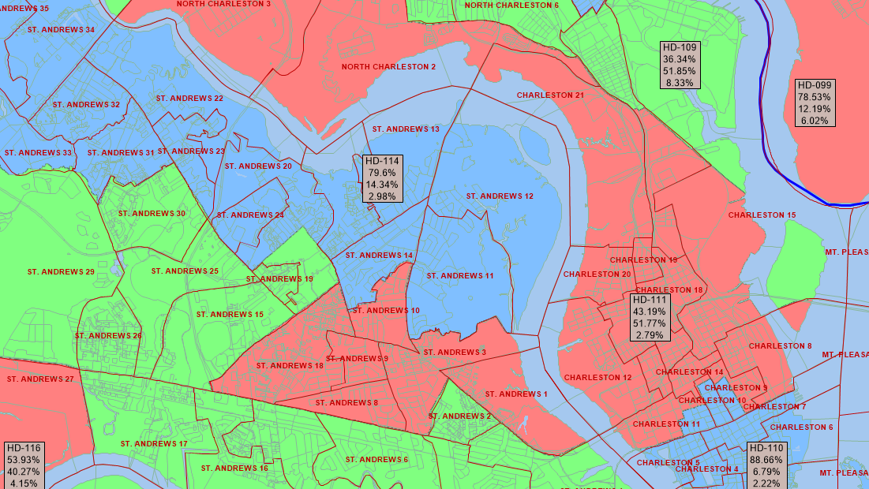
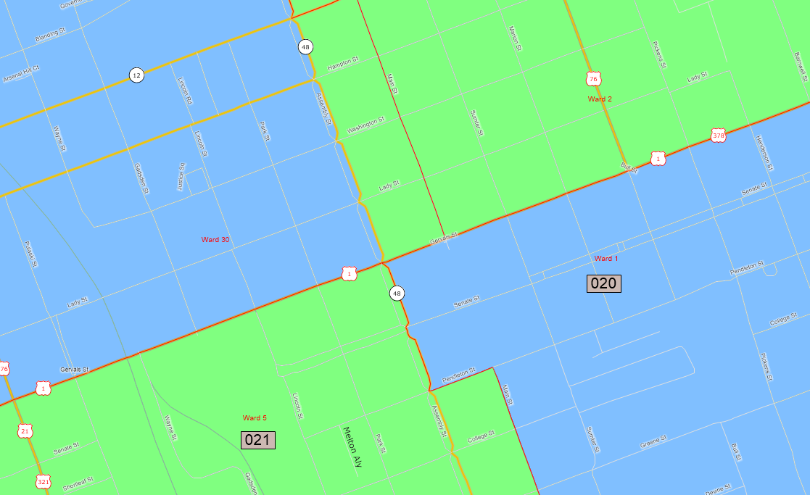
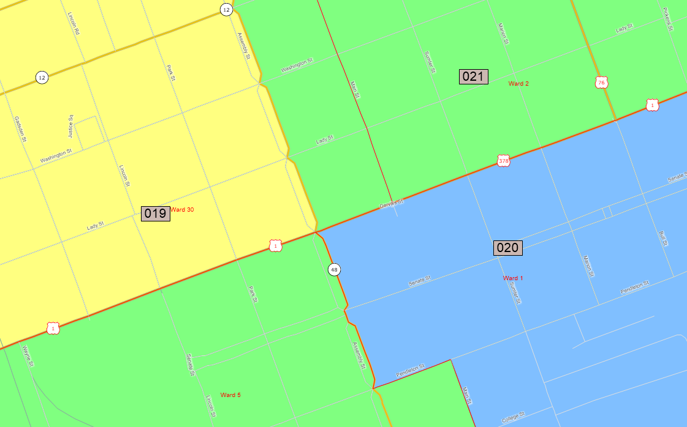

Slide 5
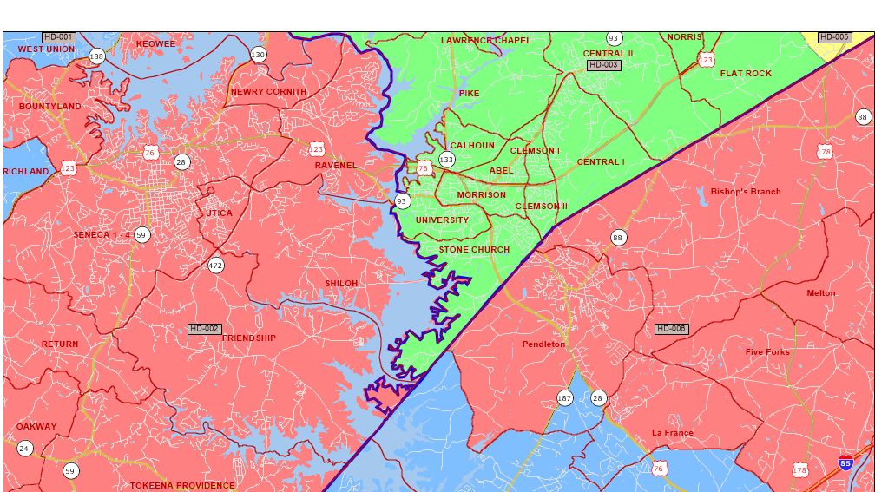

Slide 6
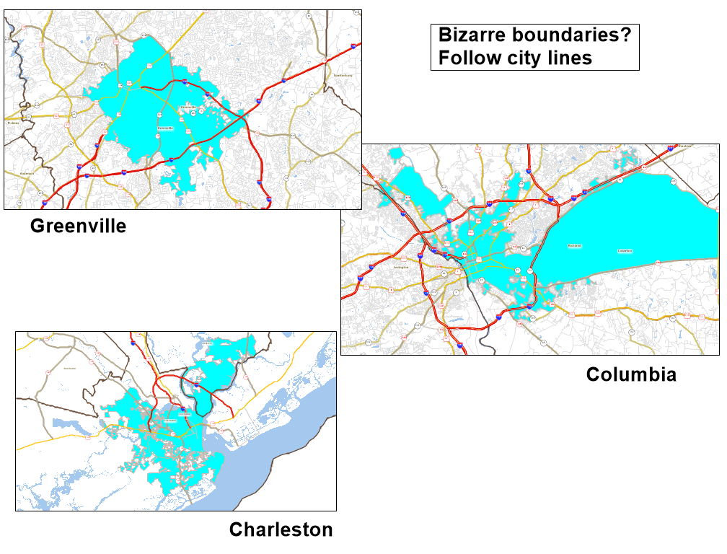

Slide 7
Preserve Communities of Interest
There is no real definition, but judges (and the SC Senate) rely on political subdivision boundaries. The Senate, or its GOP Caucus, has presented windshield sociology testimony on communities of interest.
The SC House has a definition that makes more sense from a social science perspective:
“A variety of factors may contribute to a community of interest including, but not limited to the following: (a) economic; (b) social and cultural; (c) historic influences; (d) political beliefs; (e) voting behavior; (f) governmental services; (g) commonality of communications; and (h) geographic location and features. Communities of interest shall be considered and balanced by the Election Laws Subcommittee, the House Judiciary Committee, and the South Carolina House of Representatives. County boundaries, municipality boundaries, and precinct lines (as represented by the Census Bureau’s Voting Tabulation District lines) may be considered as evidence of communities of interest to be balanced, but will be given no greater weight, as a matter of state policy, than other identifiable communities of interest.”
In public hearings and legislative debates, community of interest = the district I want to see drawn.

Slide 8
Incumbency Protection Guidelines
House - 2011
Senate - 2011
Incumbency protection
Keep legislators in their current districts
Try to avoid incumbents drawn into same district
Constituent Consistency or Preservation of Cores of Existing Districts
Incumbency protection is the core consideration in the real world, followed at a distance by partisan advantage—regardless of party. The gold standard is not a district the member can win, but one in which no one will run against them. That frequently is about drawing potential opponents and clusters of opposition out of the district. Sometimes, it’s about ensuring that particular family members and donors are in the district.

Slide 9
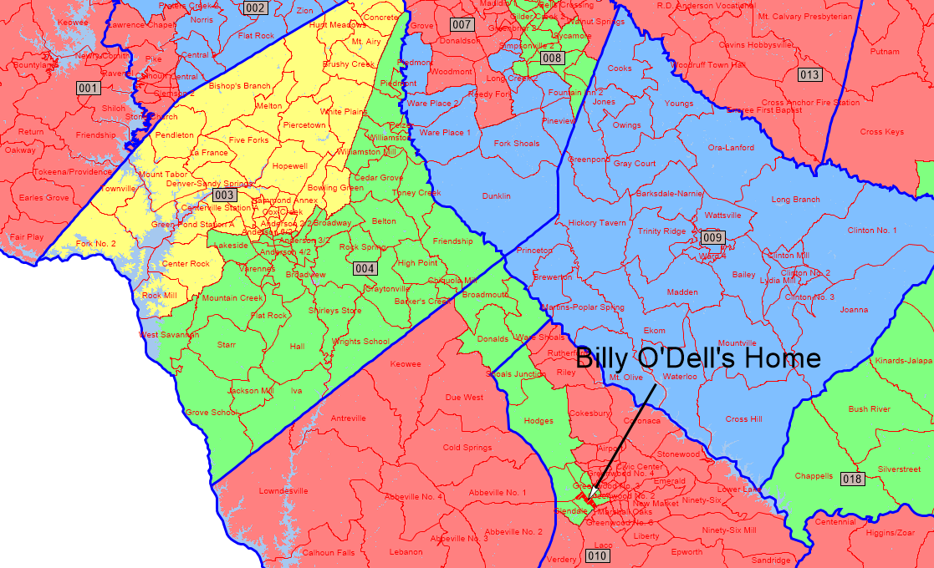

Slide 10
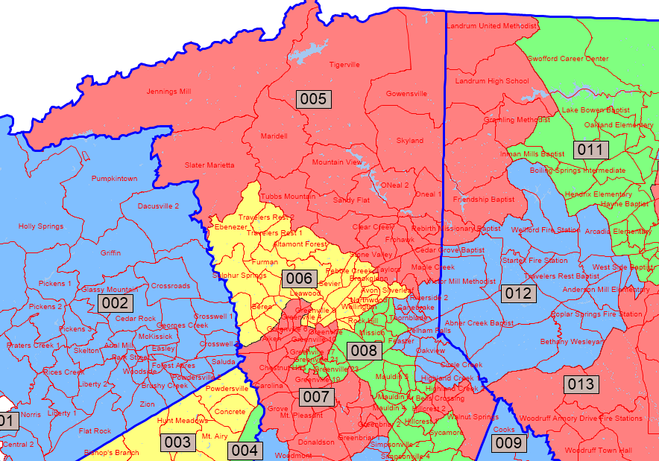
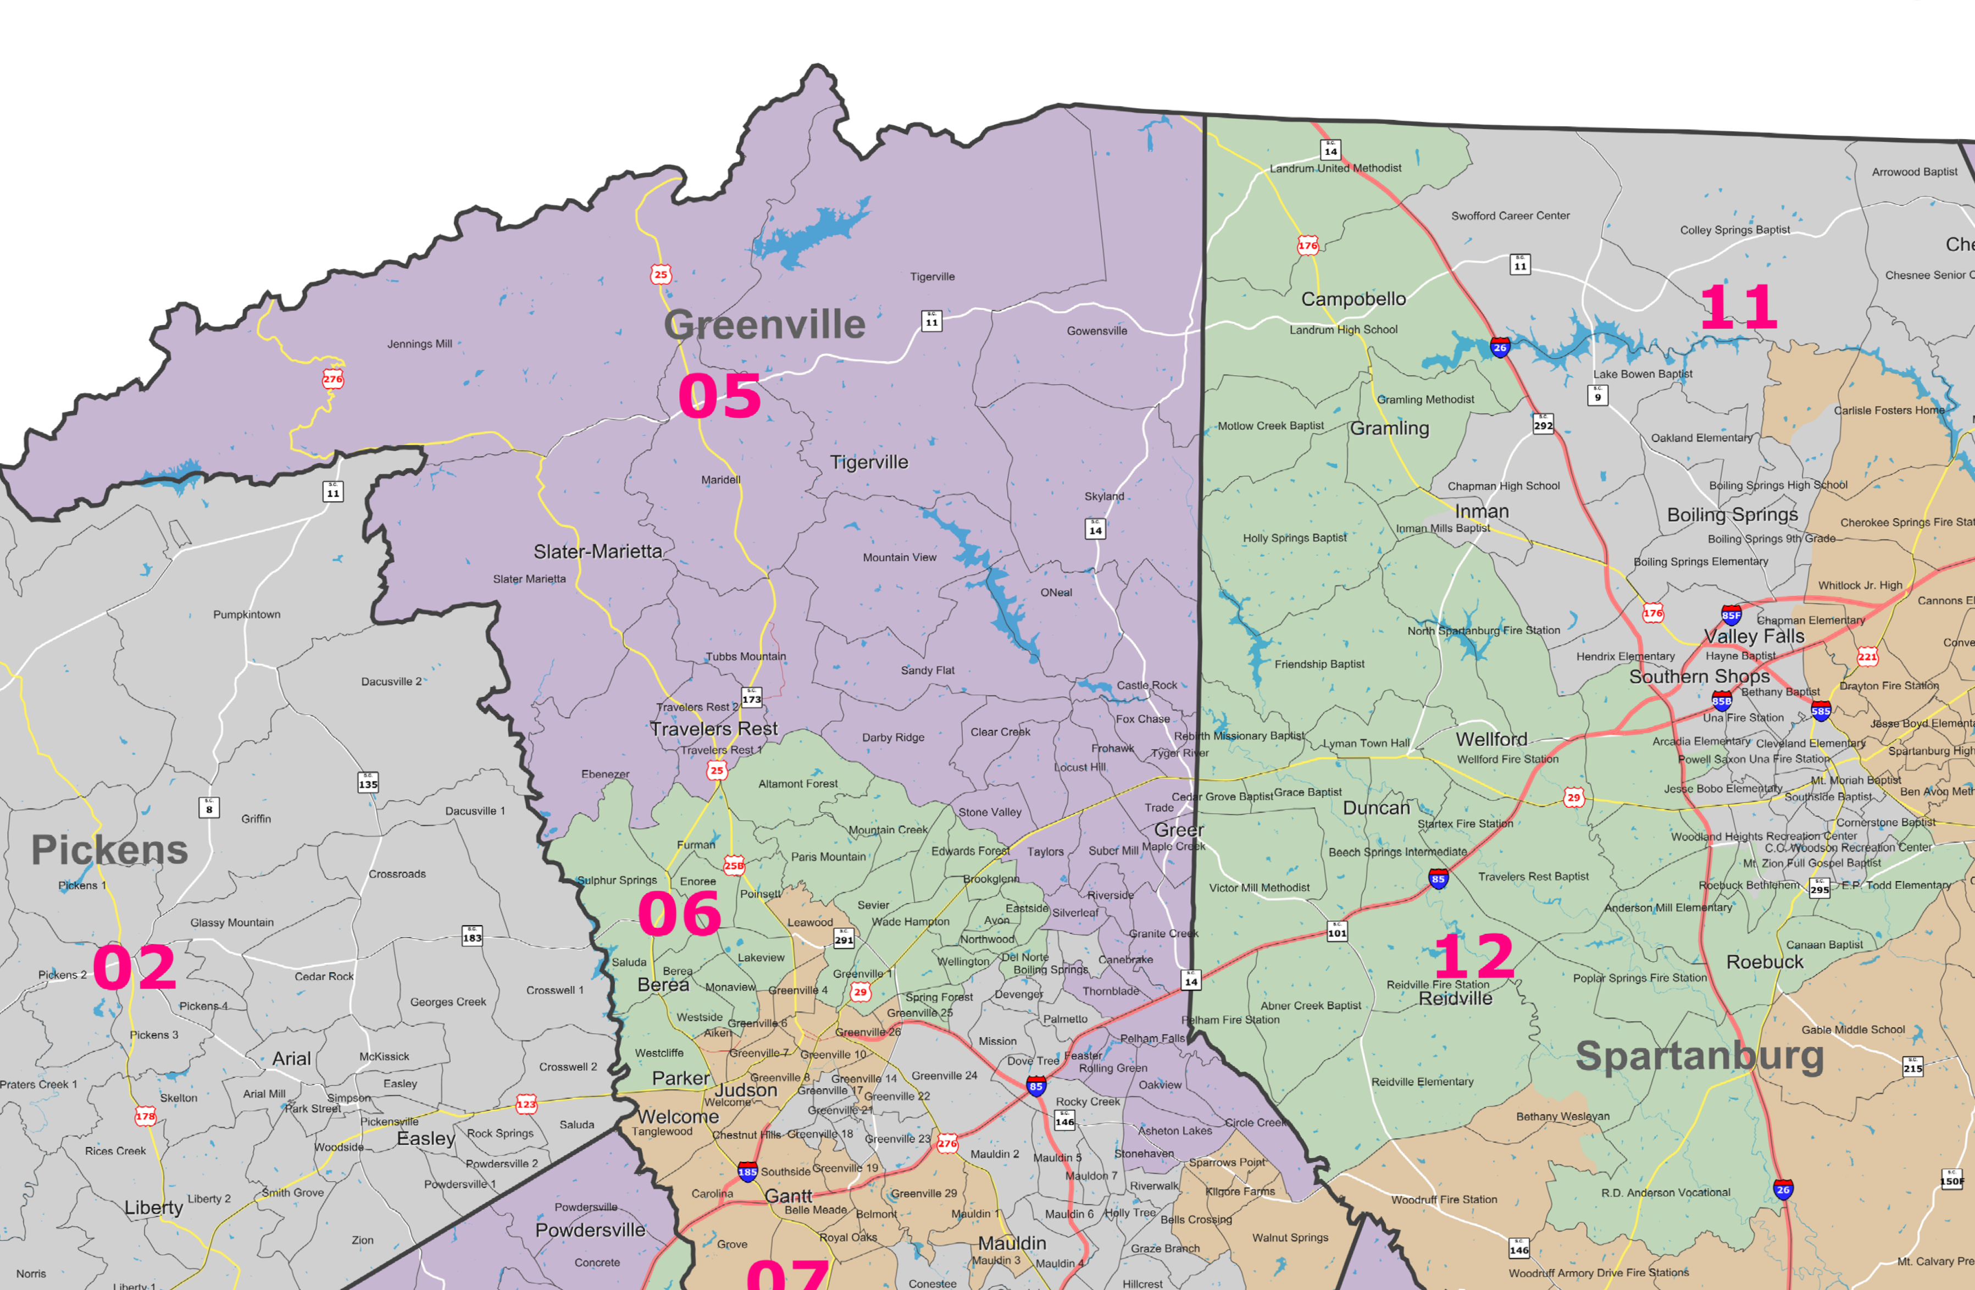
2003 Redistricting
2011 Redistricting

